Slide 1
Kubernetes Introduction
Another kubernetes introduction in 2019….

Slide 2
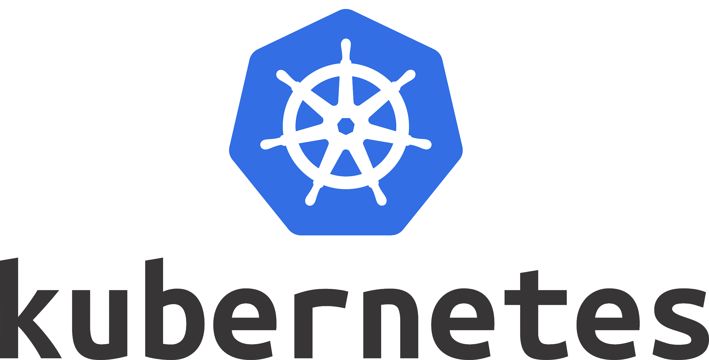
History
2003-2004 Google introduces Borg.
2014 Google releases Kubernetes as an open source version of Borg. Kubernetes is the greek word for “governor”. Founded by Joe Beda, Brendan Burns and Craig McLuckie.
2015 Kubernetes v1.0 is released
On March 6, 2018, Kubernetes Project reached ninth place in commits at GitHub
It’s usually called K8s. 8 is the numbers of characters between the “K” and the “S” in Kubernetes, leading to the developer shorthand, K8s.
Notes:
Borg: Borg was a large-scale internal cluster management system, which ran hundreds of thousands of jobs, from many thousands of different applications, across many clusters, each with up to tens of thousands of machines.

Slide 3
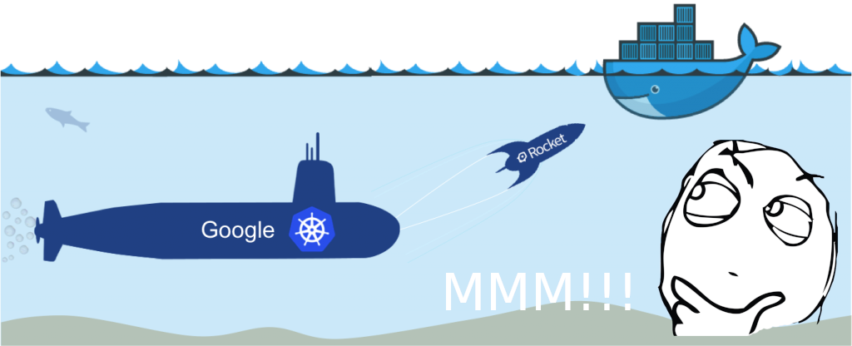
So, WTF is this shit?
It’s an open source orchestrator for deploying, scaling and monitoring containers.
Not only docker but rkt o cri-o
What if you want to keep your service under the 80% loading…
Mine it’s a soccer magazine service and mondays are crazy and it can’t keep the demanding, i want to be ready for this.
And docker didn’t have that? Yes it’s called Docker Swarm
So…?
Notes:
Rkt: similar a docker, con la salvedad de poder ejecutar contenedor que siguen la appc specification, una especificación de la OCI
Cri-o son contenedor lightweight especialmente diseñados para correr sobre k8s

Slide 4
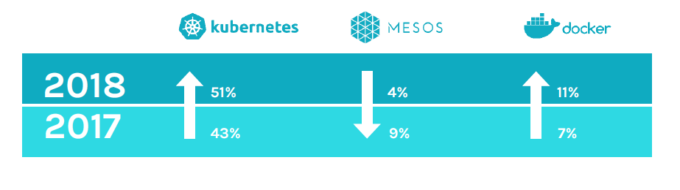
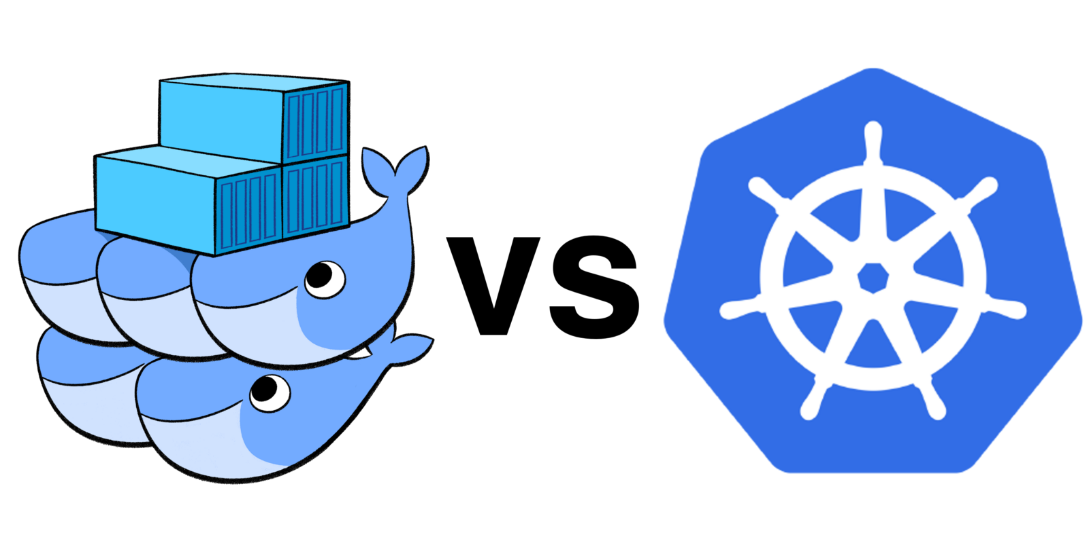
Kubernetes vs Docker Swarm
source: sysdig.com
Kubernetes
Autoscaling based on factors such as CPU utilization.
Largest community.
Do-it-yourself installation can be complex, but flexible.
Uses a separate set of tools for management, including kubectl CLI.
Not only docker.
Docker Swarm
Autoscaling based on factors such as CPU utilization.
Smaller community
Deployment is simpler and Swarm mode is included in Docker Engine (Integrates with Docker Compose and Docker CLI – native Docker tools.).
Limited to the Docker API’s capabilities.
Services can be scaled manually.
Source platform9.com

Slide 5
K8s concepts
Resource | Description | Category
Namespace | provides support for multiple virtual clusters on the same physical cluster | cluster
Node | working machine in Kubernetes. Runs a etcd and a kubelet | cluster
Pod | group of one or more containers, shared storage for those containters and options how to run them. Volumes can be shared between containers in the same pod | workloads
Service | abstraction defining logical sets of pods and policy to access them, sometimes called microservice | exposing workloads
Replica set | next-generation replication controller, different selector support, rolling update by deployments | workloads
Job | creates one or more pods and ensures that specified number of them terminate | workloads
Deployment | provides declarative updates for pods and replica sets | workloads
Volume | container's storage with ability to share files between containers within same pod | storage
Source github.com

Slide 6
K8s
Service 1
Pod1
Pod2
Service 2
Pod1
Node 1
CA_R1
CC_R1
CA_R2
App1.yaml
Pod1
Containers
CA
CB
Replicas: 2
Pod2
Containers
CC
Replicas: 3
Node 2
CA_R2
CC_R2
MASTER
Node 3
CB_R1
CC_R3
Node 4
CB_R2
CC_R2
Notes:
Mater:
Maintain the state of the Kubernetes runtime service
It’s the point of entry for all the clients to manager the kubernetes components, like nodes, pods, services, etc…
Node:
Represents the resource provided for provisioning pods
Runs a etcd (key-value store designed to securely store data across a cluster) and a kubelet daemon (ensures that the containers described in the PodSpecs are running and healthy)
Service:
It’s an abstraction which defines a logical set of pods and a policy to access them (usually called micro-service)
A service determines a TCP or UDP port reservation

Slide 7

Let’s rock
Install kubectl https://kubernetes.io/docs/tasks/tools/install-kubectl/
Check the cluster state (this will fail)
Install Minikube https://kubernetes.io/docs/tasks/tools/install-minikube/#linux
sudo apt-get update && sudo apt-get install -y apt-transport-https curl -s https://packages.cloud.google.com/apt/doc/apt-key.gpg | sudo apt-key add - echo "deb https://apt.kubernetes.io/ kubernetes-xenial main" | sudo tee -a /etc/apt/sources.list.d/kubernetes.list sudo apt-get update sudo apt-get install -y kubectl echo "source <(kubectl completion bash)" >> ~/.bashrc // add autocompletion to your current shell
kubectl cluster-info
curl -Lo minikube https://storage.googleapis.com/minikube/releases/latest/minikube-linux-amd64 sudo install minikube-linux-amd64 /usr/local/bin/minikube sudo apt install virtualbox virtualbox-ext-pack minikube start
Notes:
Kubectl: the command line tool
Minikue: it’s a tool that makes it easy to run Kubernetes locally. Minikube runs a single-node Kubernetes cluster inside a VM

Slide 8
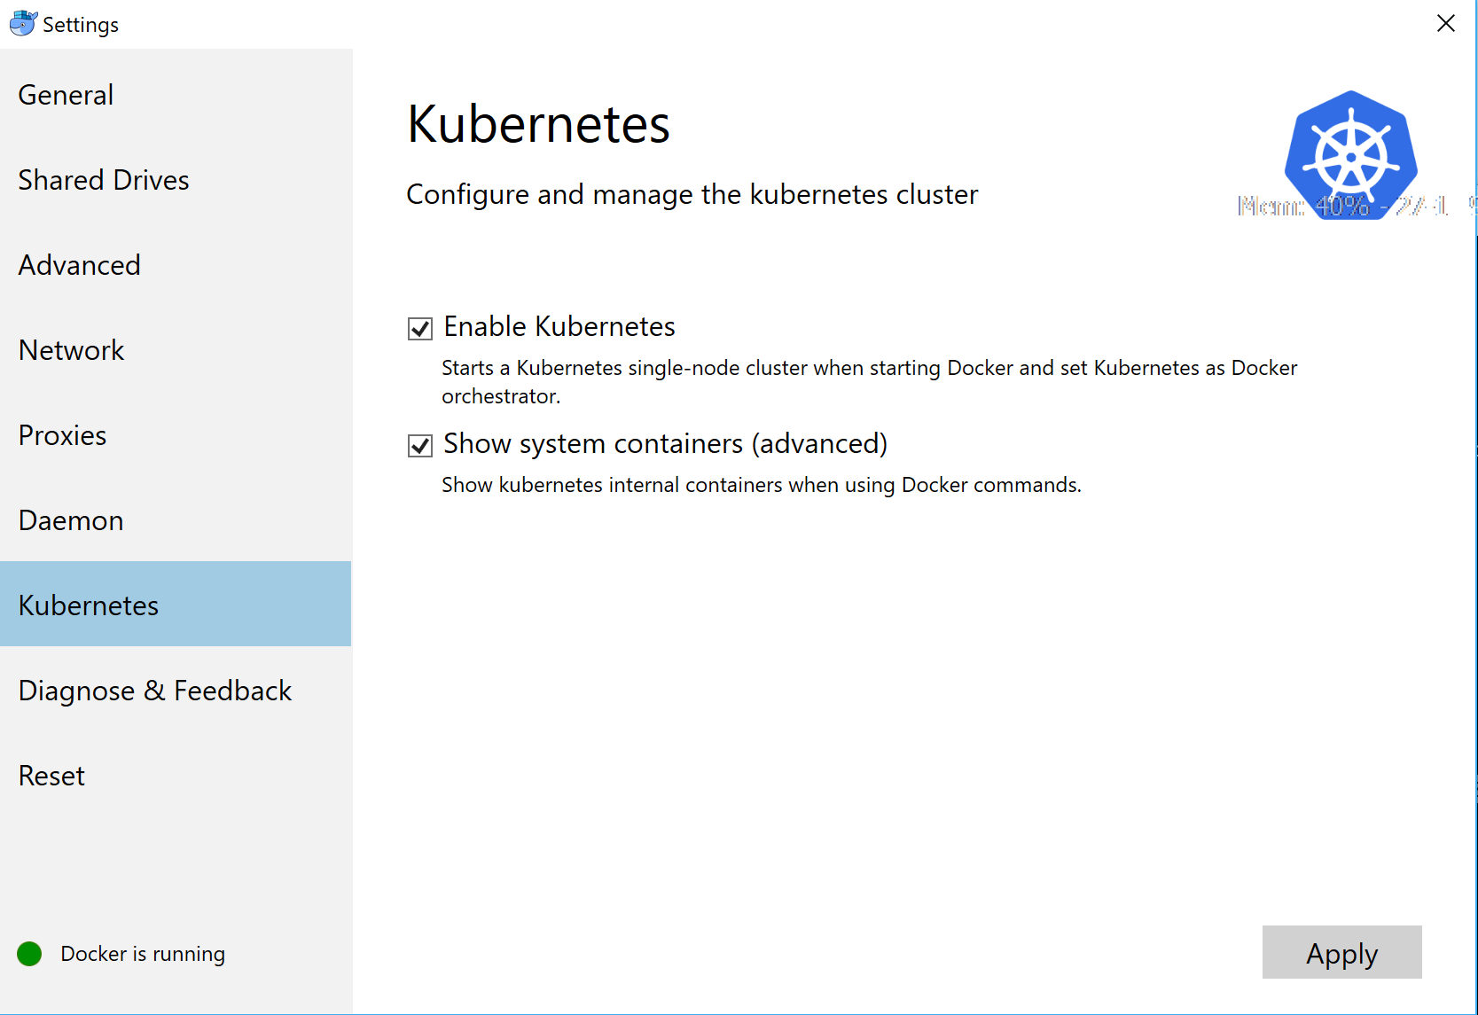
Let’s rock in windows
Notes:
Kubectl: the command line tool
Minikue: it’s a tool that makes it easy to run Kubernetes locally. Minikube runs a single-node Kubernetes cluster inside a VM

Slide 9
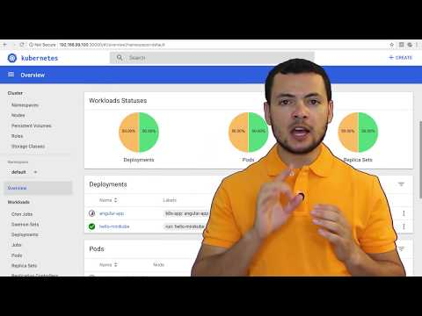
Kubernetes minikube dashboard

Slide 10

Kubernetes rancher dashboard
Open-source software for delivering Kubernetes-as-a-Service
Runs in docker
Manage different platforms AWS (Amazon), GCloud (Google), Azure (Microsoft), Digitalocean…
sudo docker run -d --restart=unless-stopped -p 80:80 -p 443:443 rancher/rancher:latest

Slide 11
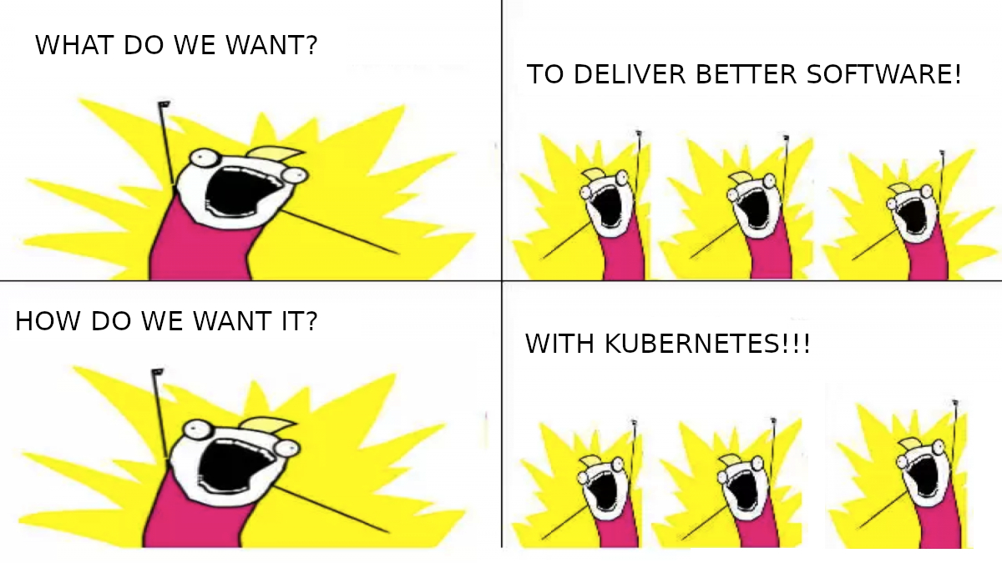
Gracias! preguntas?
Sources:
https://www.docker.com
https://hub.docker.com
https://docs.docker.com
Enrique Mingorance Cano
Center Expert Specialist, HPC Alicante
ginxo
emingora@everis.com

